Slide 1
Muscles and fascial plane of the neck

Slide 2
Structures Palpated in the Midline
body of the hyoid bone
thyroid cartilage
cricoid cartilage
Trachea
isthmus of the thyroid gland
suprasternal notch

Slide 3
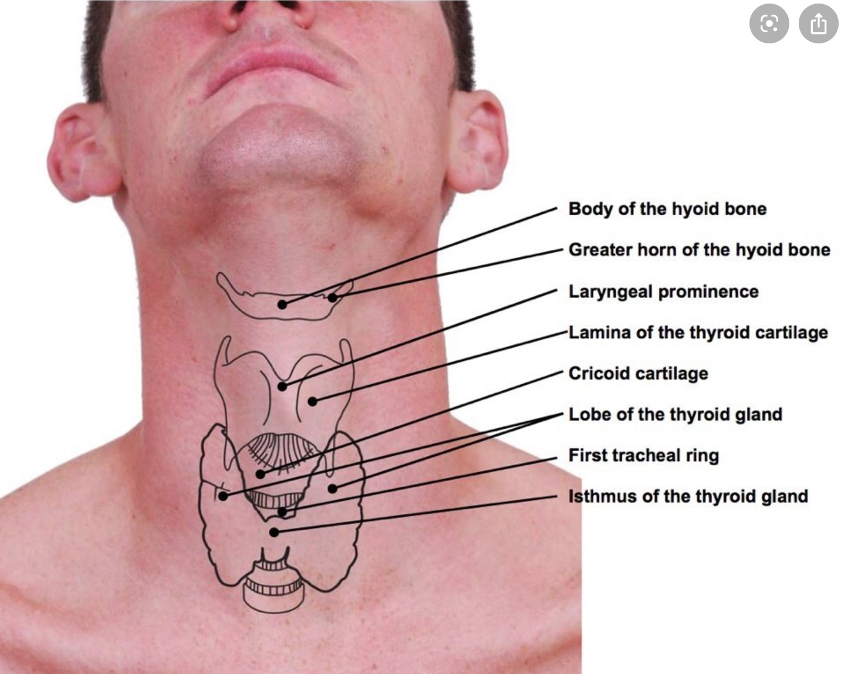

Slide 4
Structures Palpated Posteriorly
Inion
Nuchal groove
Vertebra prominence
Ligamentum nuchae which covers spines of C2 to C6

Slide 5
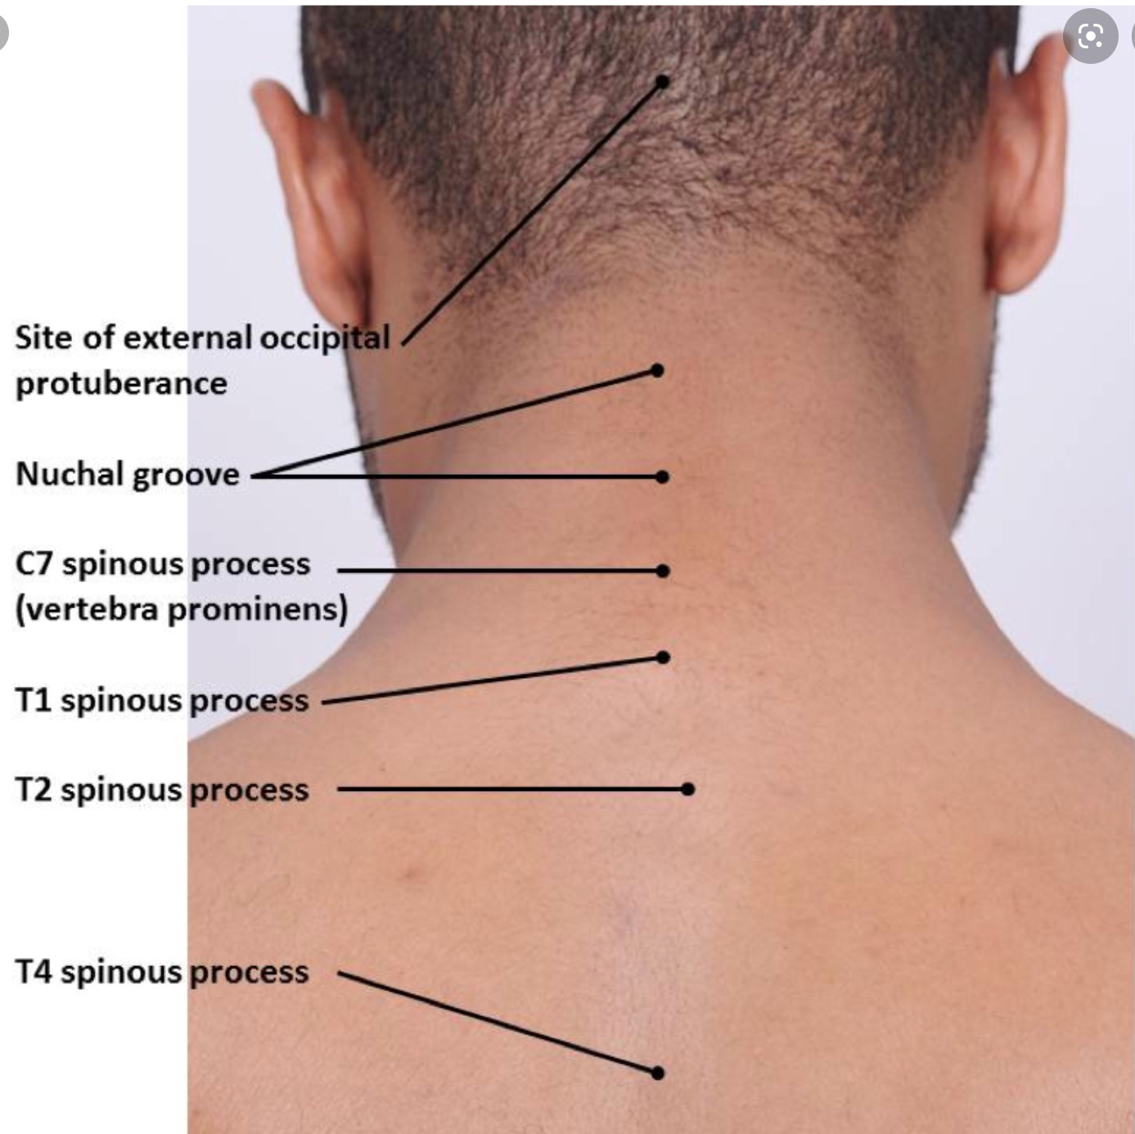

Slide 6
Structures Palpated Laterally
Sternocleido-mastoid muscle
Trapezius muscle
External jugular veins

Slide 7
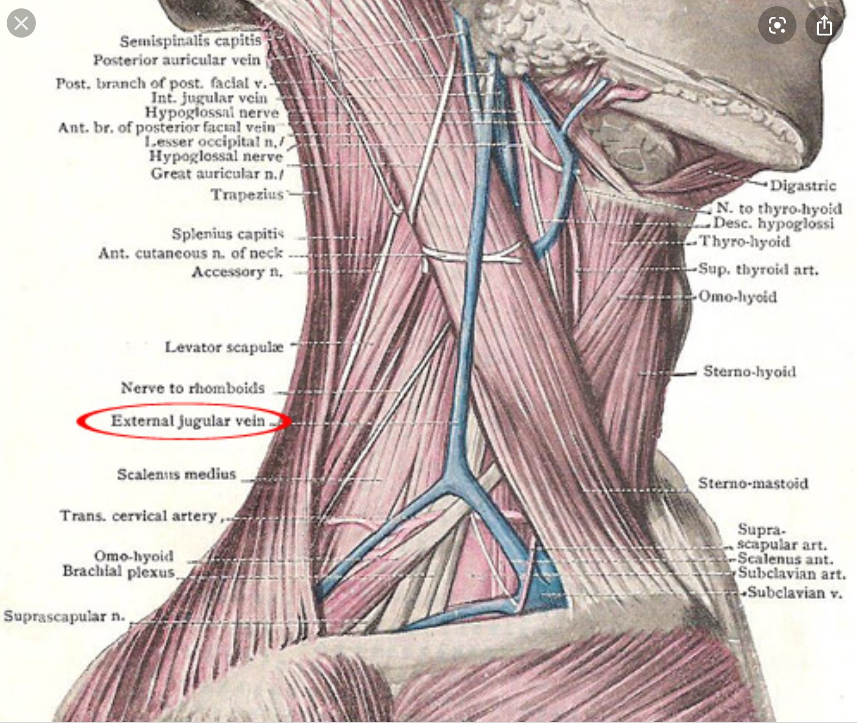

Slide 8
Muscles of the neck

Slide 9
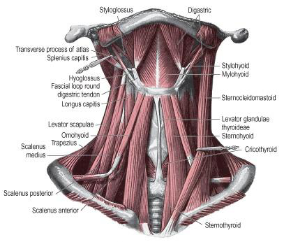

Slide 10
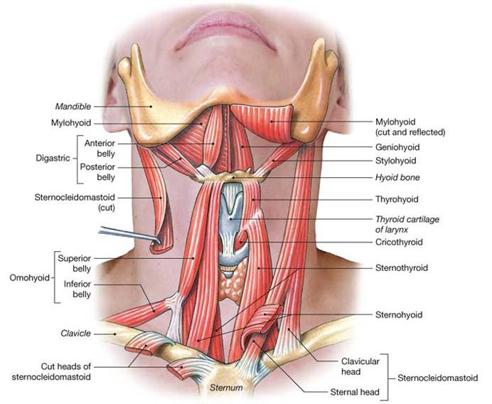
Anterior view of neck muscles

Slide 11
PLATYSMA
•Platysma is a broad sheet of muscle of varying prominence.
•arises from the fascia covering the upper parts of pectoralis major and deltoid.
•Its fibers cross the clavicle and ascend medially in the side of the neck.
•Anterior fibers interlace across the midline with the fibers of the contra lateral muscle, below and behind the symphysis menti.
•Other fibers attach to the lower border of the mandible or to the lower lip or cross the mandible to attach to skin and subcutaneous tissue of the lower face.

Slide 12
•Vascular supply
•Platysma receives its blood supply from
–the submental branch of the facial artery
–and the suprascapular artery from the thyrocervical trunk of the subclavian artery.
•Innervation
-Platysma is innervated by the cervical branch of the facial nerve which descends on the deep surface of the muscle close to the angle of the mandible
. Action
-Contraction diminishes the concavity between the jaw and the side of the neck and produces tense oblique ridges in the skin of the neck.

Slide 13
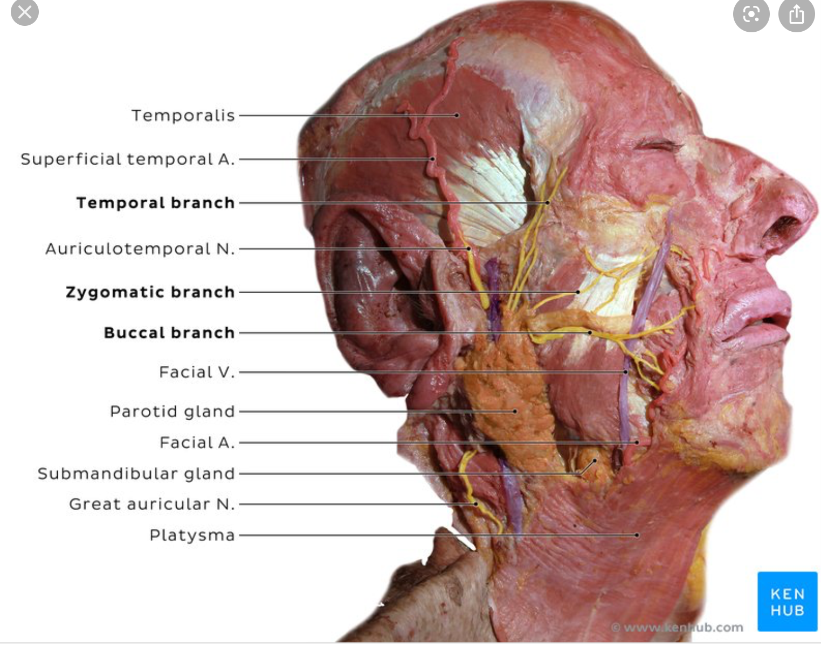
Platysma muscle

Slide 14
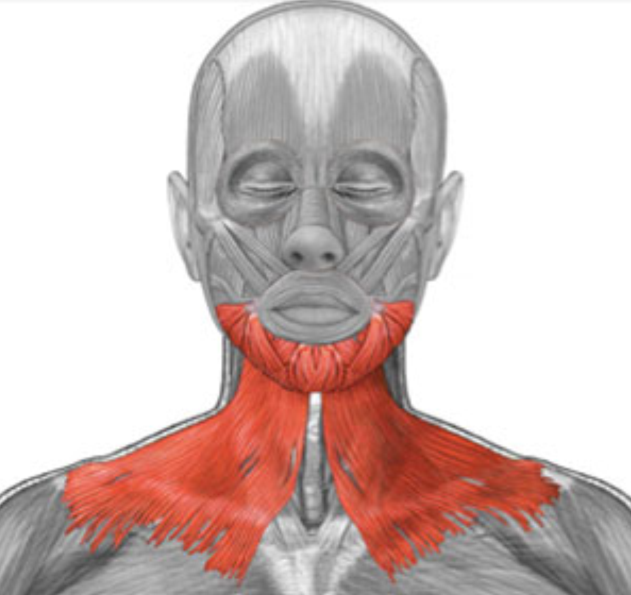

Slide 15
Sternocleidomastoid Muscle
Origin | Insertion | Action | Nerve Supply
Two heads: Sternal head –manubrium sterni Clavicular head - Medial 2/3 of the clavicle | Mastoid process of the of the temporal bone and lateral half of the superior nuchal line. | Bilateral: Flex the neck Single: Flex the head and laterally rotate to the opposite side | 1. Spinal accesory nerve 2. Anterior primary rami of spinal nerves C2 and C3.

Slide 16
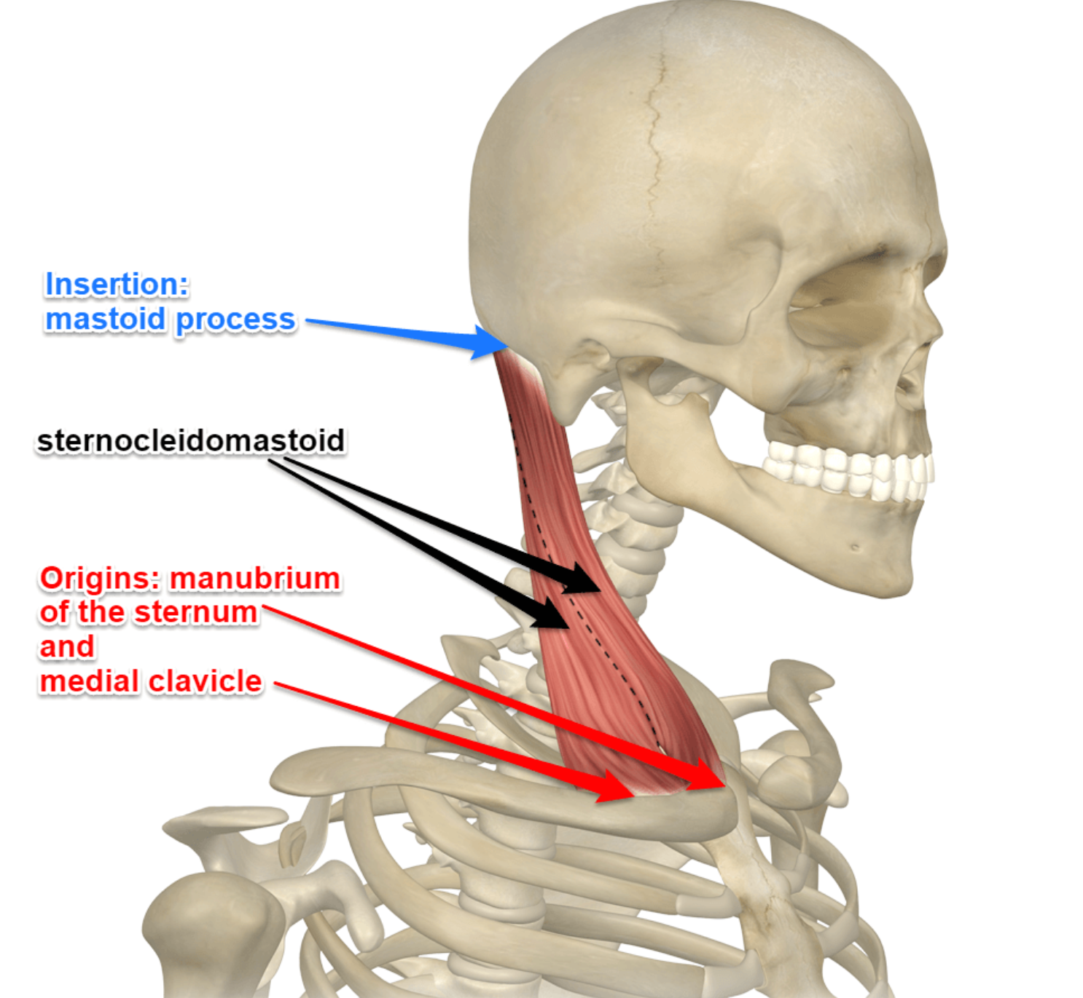
sternocleidomastoid

Slide 17
Trapezius Muscle
Origin | Insertion | Action | Nerve Supply
External occipital protruberance, the medial half of the superior nuchal line, the ligamentum nuchae, and the lower cervical and all the thoracic spines | Fibers originating from the head insert into the lateral third of the clavicle, and the remaining fibers insert into the acromion process and spine of the scapula | Contract to rotate and elevate the scapula. Its cervical portion, acting bilaterally, can extend the head and singly, it can rotate the head and face to the opposite side | 1. Spinal accessory nerve 2. Anterior primary rami of the spinal nerves C3 and C4.

Slide 18
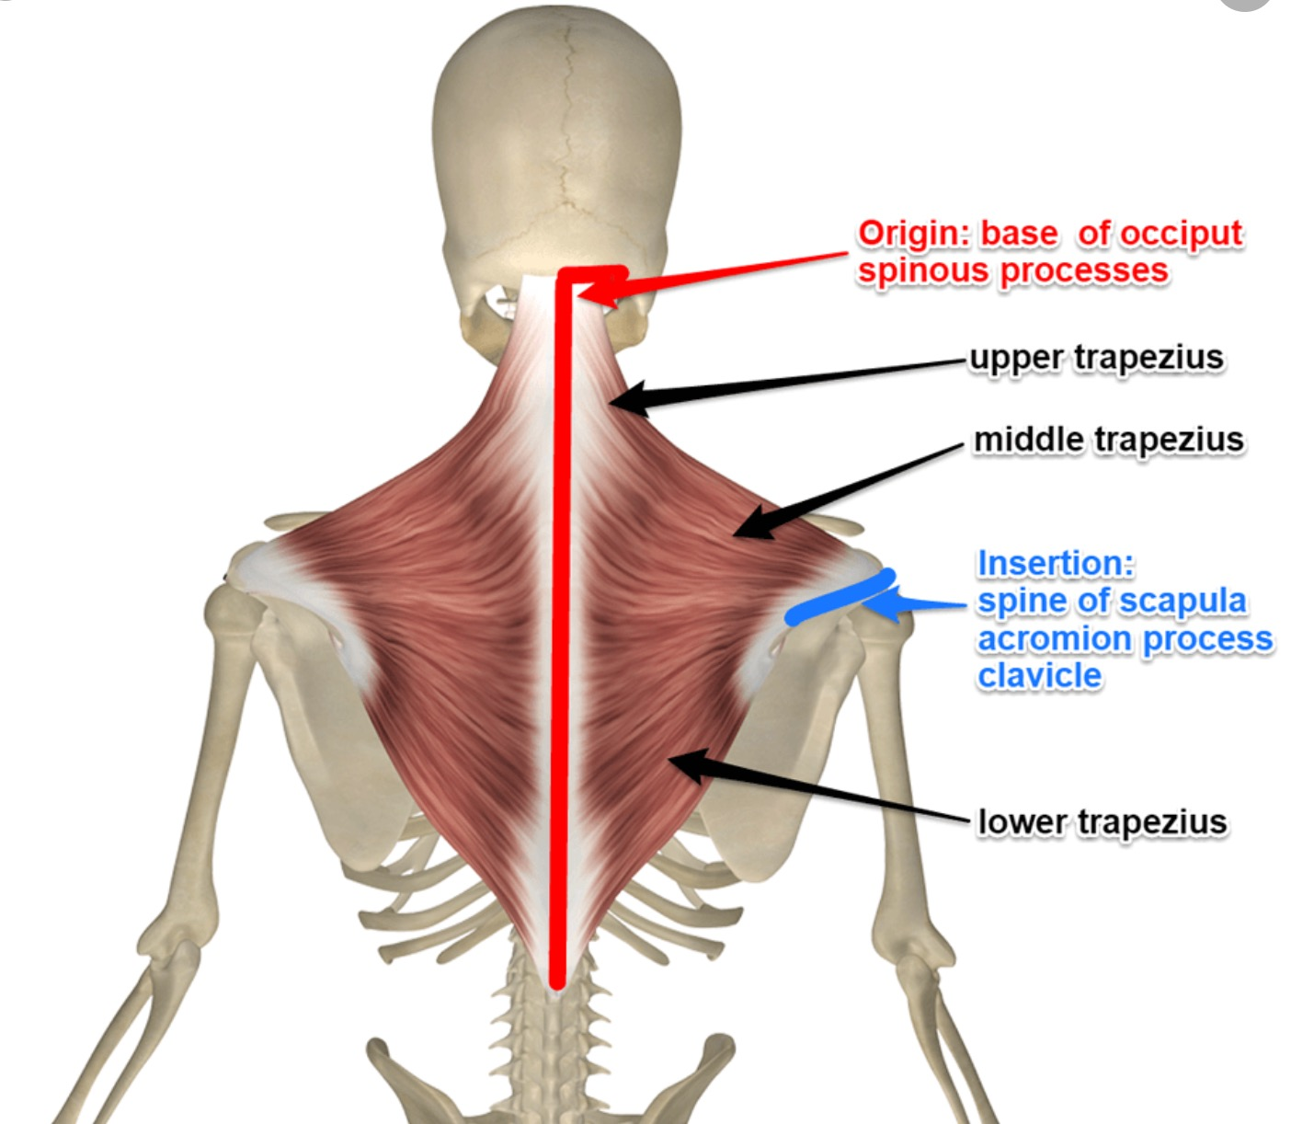
Trapezius muscle

Slide 19
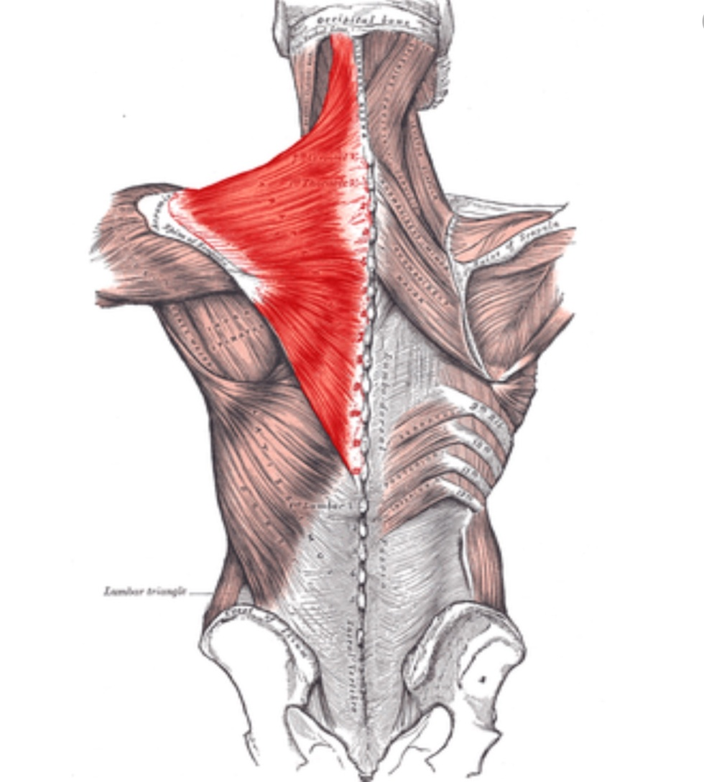
Trapezius muscle

Slide 20
I. Infrahyoid Muscles
Muscle | Origin | Insertion | Action | Nerve Supply
Omohyoid | Inferior belly: Superior border of the scapula Superior belly: Intermediate tendon | Inferior belly: Intermediate tendon Superior belly: Lower border of the body of the hyoid bone | Depresses the hyoid bone and larynx | Ansa cervicalis (APR of C1, C2, C3)
Sternohyoid | Manubrium of the sternum, posterior aspect | Lower border of the body of the hyoid bone | Depresses the hyoid bone and larynx | Ansa cervicalis (APR of C1, C2, C3)

Slide 21
Infrahyoid Muscles
Muscle | Origin | Insertion | Action | Nerve Supply
Sternothyroid | Manubrium of the sternum, posterior aspect | Oblique line of thyroid cartilage | Depresses the larynx | Ansa cervicalis (APR of C1, C2, C3)
Thyrohyoid | Oblique line of thyroid cartilage | Body and greater horn of hyoid bone, lower border | Depresses the hyoid bone | Thyrohyoid branch of the hypoglossal nerve

Slide 22
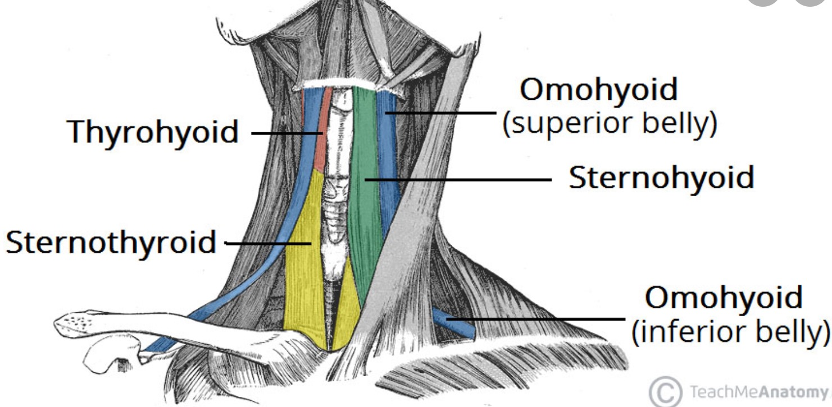
Infra-hyoid muscles

Slide 23
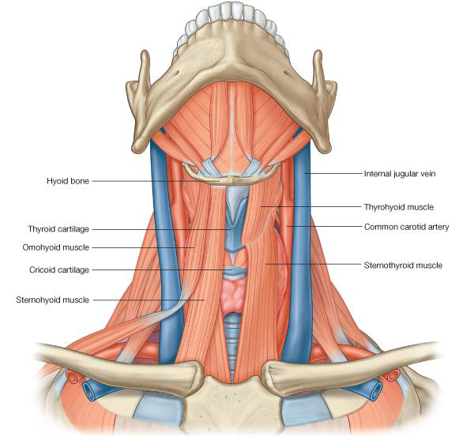
Infra-hyoid muscles

Slide 24
Suprahyoid Muscles
Muscle | Origin | Insertion | Action | Nerve Supply
Mylohyoid | Mylohyoid line on the medial aspect of mandibular body | Median raphe and body of hyoid | Elevates the hyoid bone, base of the tongue, and floor of the mouth | Nerve to mylohyoid muscle
Geniohyoid muscle | Inferior border genial tubercle of the mandible | Body of hyoid bone | Elevates hyoid bone, protracts hyoid bone | APR of C1

Slide 25
II. Suprahyoid Muscles
Muscle | Origin | Insertion | Action | Nerve Supply
Stylohyoid | Styloid process | Greater horn of hyoid bone | Elevates hyoid bone | Facial nerve
Digastric (Posterior belly) | Digastric notch of the temporal bone at the base of the skull | Intermediate tendon | Raises the hyoid bone | Facial nerve
Digastric (anterior belly) | Intermediate tendon | Digastric fossa of the mandible | Elevates the hyoid bone | Nerve to the mylohyoid muscle

Slide 26
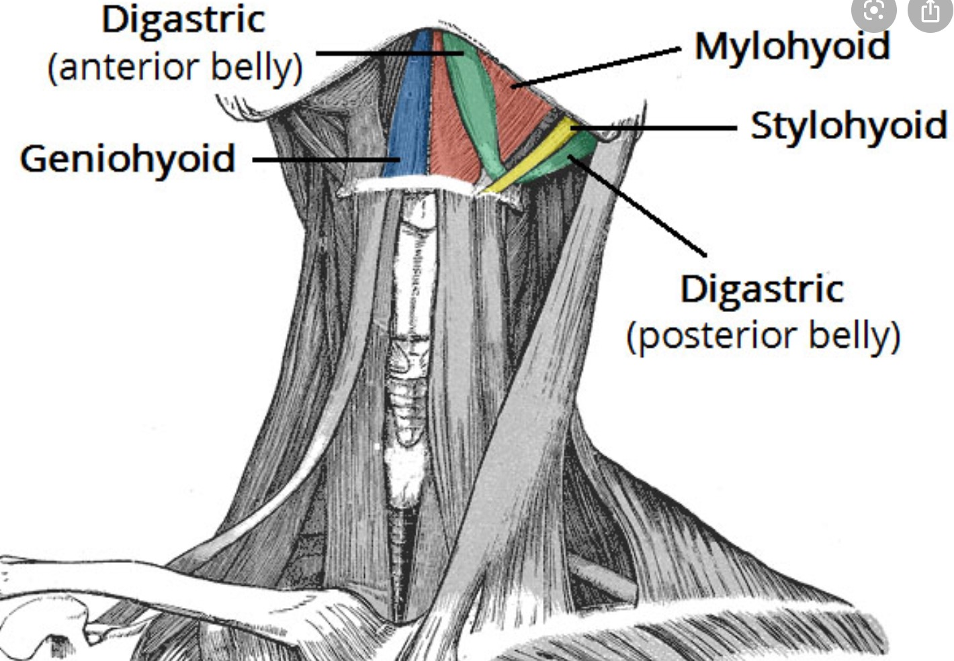

Slide 27
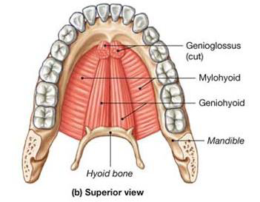
Muscles that form the floor of the oral cavity, superior view

Slide 28
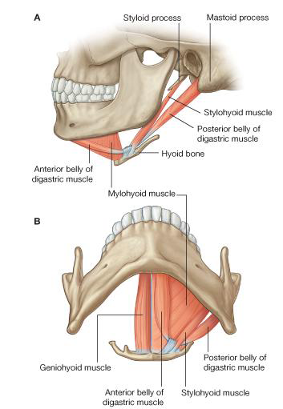
Suprahyoid muscles, lateral and inferior view

Slide 29
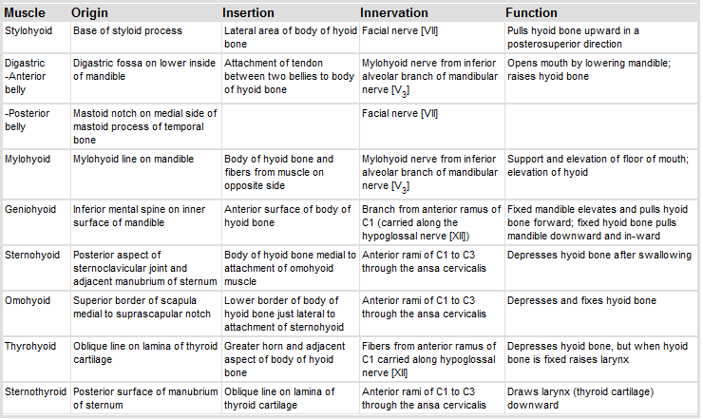
Muscles in the anterior triangle of the neck

Slide 30
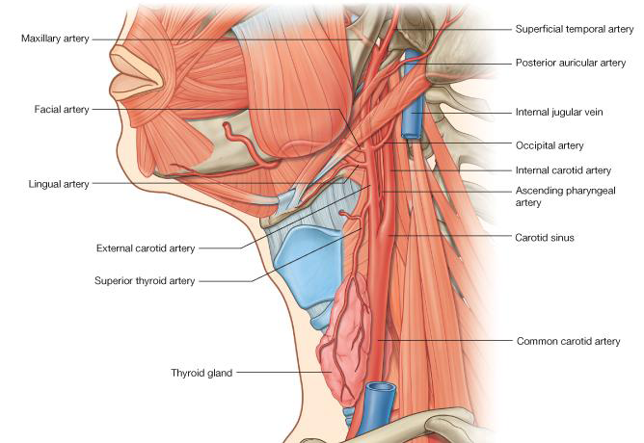
Carotid system

Slide 31
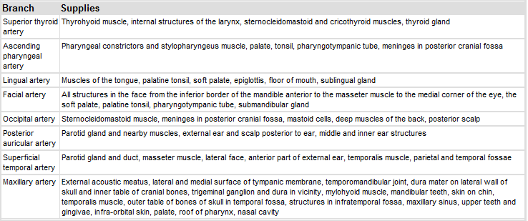
Branches of the external carotid artery

Slide 32
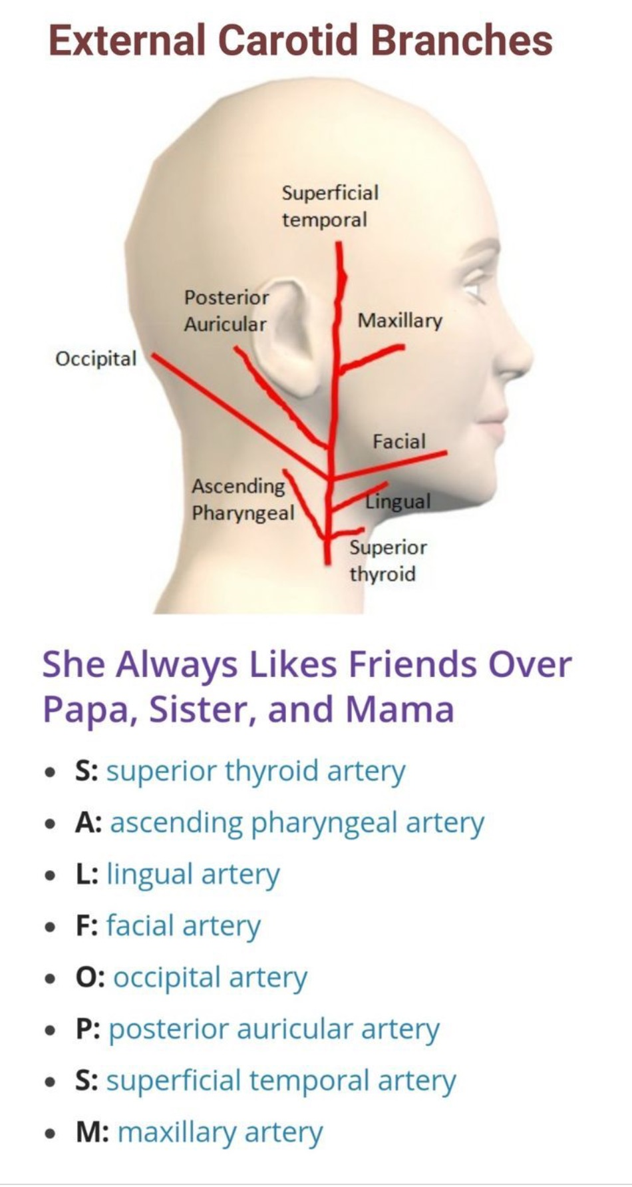

Slide 33
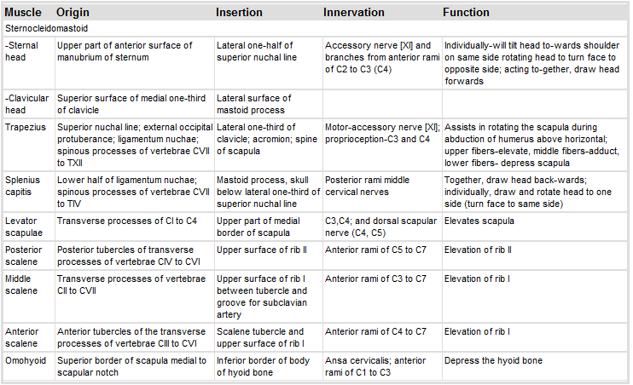
Muscles associated with the posterior triangle of the neck

Slide 34
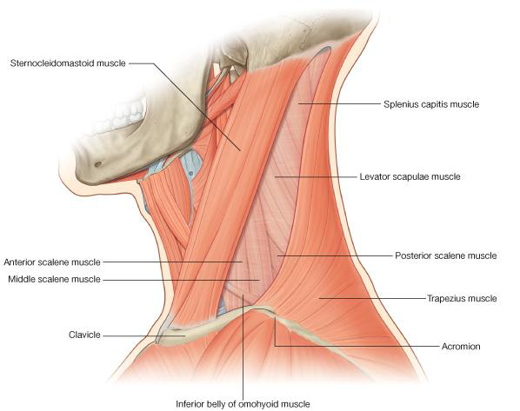
Muscles of the posterior triangle of the neck

Slide 35
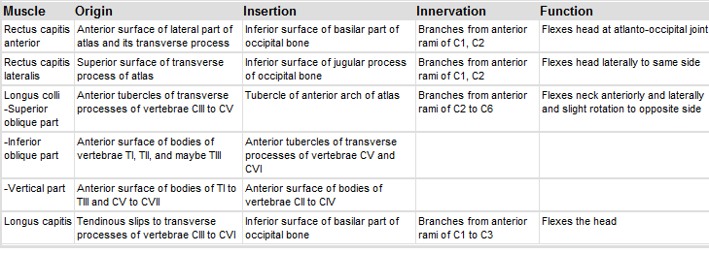
Prevertebral and lateral muscles

Slide 36
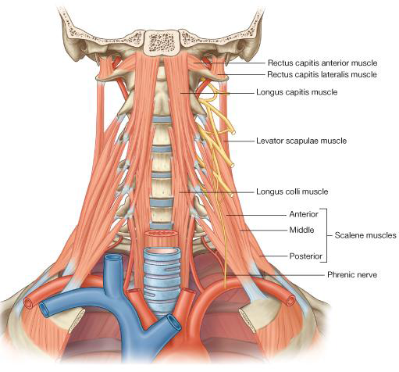
Prevertebral and lateral muscles

Slide 37
Fascial planes of the neck

Slide 38
The fascia of the neck has a number of unique features.
•The superficial fascia in the neck contains a thin sheet of muscle (the platysma),
•Platysma begins in the superficial fascia of the thorax,
•runs upwards to attach to the mandible
•and blend with the muscles on the face,
•is innervated by the cervical branch of the facial nerve [VII], and is only found in this location.

Slide 39
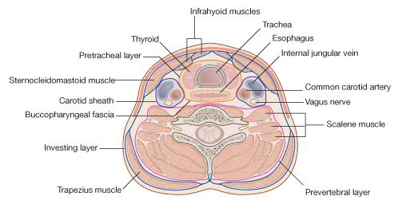
Fascia of neck, transverse view

Slide 40
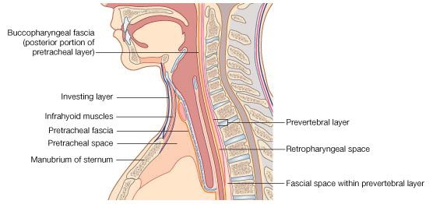
Fascia of the neck, sagittal view

Slide 41
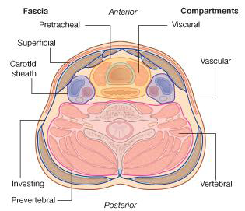

Slide 42
:Deep to the superficial fascia
•is deep cervical fascia which is organized into several distinct layers
1.an investing layer: which surrounds all structures in the neck;
2.the prevertebral layer: which surrounds the vertebral column and the deep muscles associated with the back;
3.the pretracheal layer: which encloses the viscera of the neck.
4.the carotid sheaths: which receive a contribution from the other three fascial layers and surround the two major neurovascular bundles on either side of the neck.

Slide 43
Carotid sheath
•Each carotid sheath is a column of fascia that surrounds the common carotid artery, the internal carotid artery, the internal jugular vein, and the vagus nerve as these structures pass through the neck.
•It receives contributions from the investing, prevertebral, and pretracheal layers, though the extent of each component's contribution varies

Slide 44
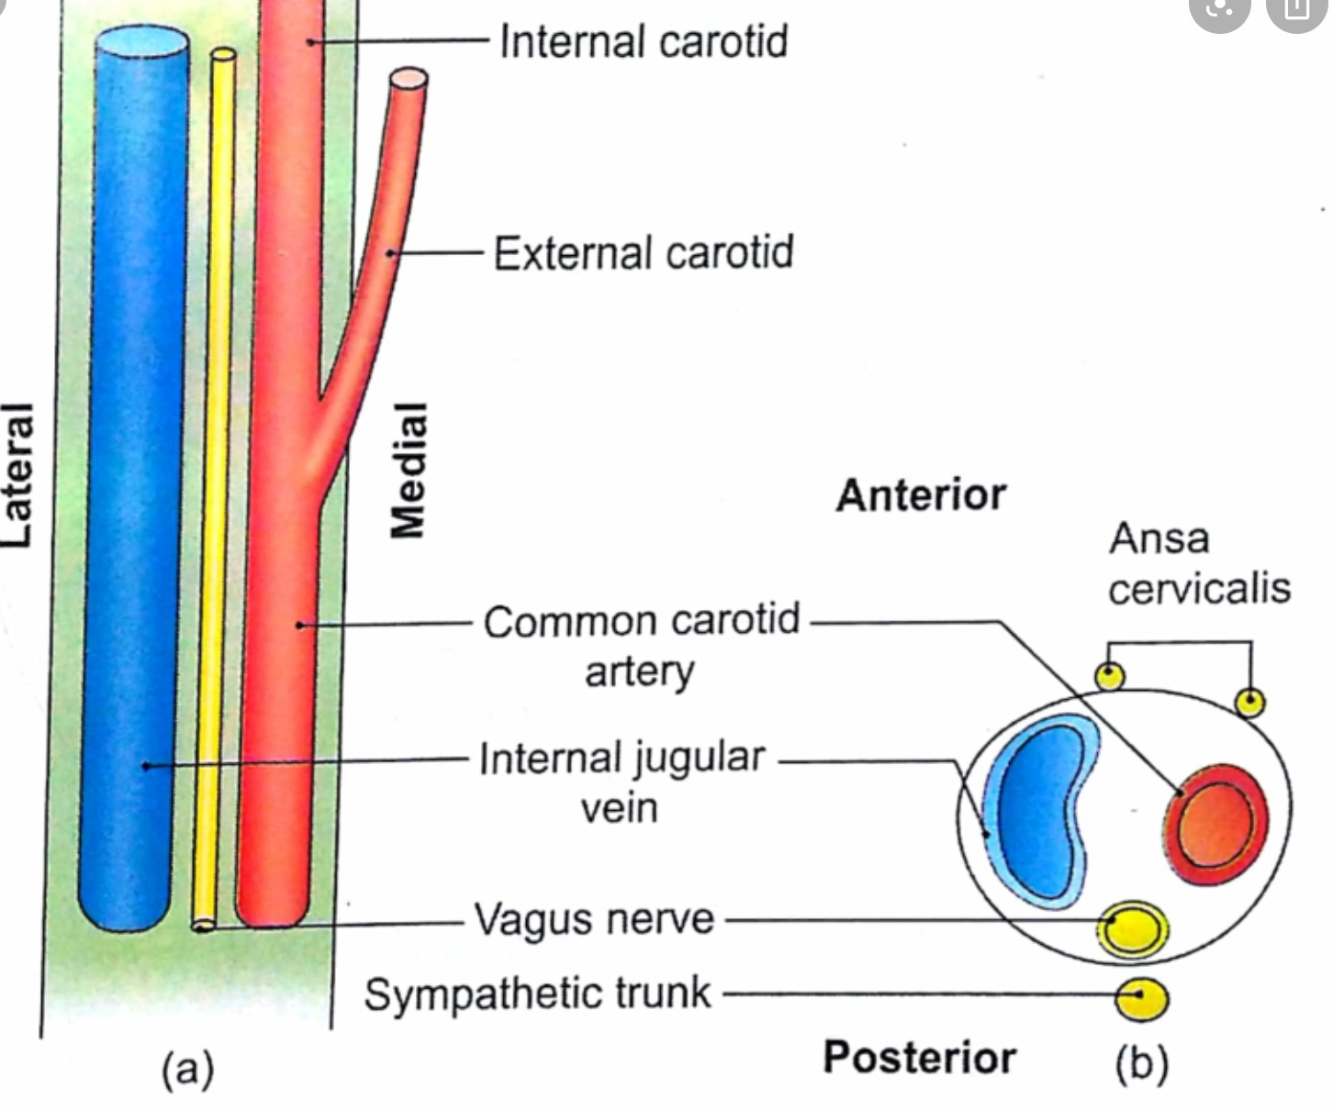
Contents of carotid sheath

